Slide 1




LOGIN
REGISTER
Notes:
HOME SCREEN – SEEN WHEN YOU ARRIVE AT WEBSITE

Slide 2

USER ID:
FORGOT ID?
PASSWORD:
REGISTER
FORGOT PASSWORD?
FEED YOUR OBSESSION
Notes:
LOGIN SCREEN

Slide 3

NAME:
ADDRESS:
CITY:
STATE/PROV:
LOGIN
COUNTRY:
ZIP/POSTAL:
D.O.B.:
USERNAME:
PASSWORD:
CONFIRM PASSWORD:
AGREE TO TERMS AND CONDITIONS
SUBMIT
Notes:
REGISTER SCREEN – CAN ALSO REGISTER USING FACEBOOK OR GOOGLE PLUS

Slide 4
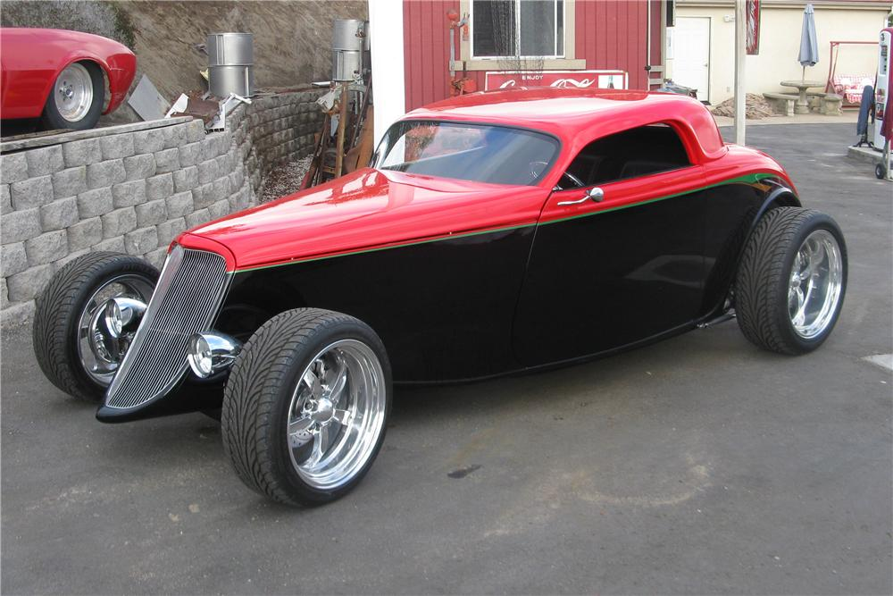

MONEY: $125000
TOKENS: 5
PRESTIGE: 275
MILE MARKERS: 4
ADAM JUST PURCHASED 1932 FORD CUSTOM ROADSTER…..JIM JUST PURCHASED 1956 FORD THUNDE
MY VEHICLES
HOME VEHICLE IF SELECTED FROM CARS OWNED
OR
EMPTY LOOKING GARAGE
IF NOT SELECTED
MY PROFILE
MY PROJECTS
MY MESSAGES
MY GARAGE
RANKINGS
GO TO AUCTION
SEARCH
SELECT PARTS SUPPLY
BUY BUSINESS
BUY UPGRADES
FAQ/TUTORIAL
Notes:
PLAYER HOME DASHBOARD – STARTING POINT ONCE INSIDE THE GAME

Slide 5
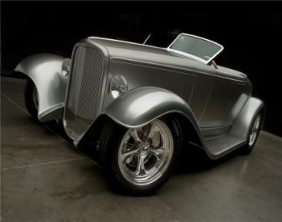
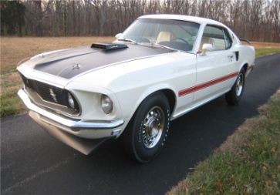
MONEY: $125000
TOKENS: 5
PRESTIGE: 275
MILE MARKERS: 4
1932 FORD CUSTOM ROADSTER - Over ninety percent of the car is one-off parts. The body is all steel. Received three awards at the America's Most Beautiful Roadster Show in 2010, "Outstanding Engineering", "Achievement Award" and "Outstanding Paint."
DRIVETRAIN
BODY
INTERIOR
DOCUMENTATION
88%
96%
90%
90%
SELECT
1969 FORD MUSTANG 428 CJ “R” - White with white interior, C-6 automatic, factory "R" Code with date code correct 428cid Cobra Jet, Ram Air Shaker Hood, air conditioning, sport deck rear seat, power steering and brakes, tilt-away wheel, speed control, AM radio, tinted glass and tach.
DRIVETRAIN
BODY
INTERIOR
DOCUMENTATION
58%
70%
60%
66%
SELECT
Notes:
VEHICLE PAGE – THIS IS AN OVERVIEW PAGE OF VEHICLES WITH A PERCENTAGE OF 35% AND HIGHER

Slide 6

MONEY: $125000
TOKENS: 5
PRESTIGE: 275
MILE MARKERS: 4
MAKE HOME SCREEN VEHICLE
ENGINE 54%
TRANSMISSION 66%
DRIVE AXEL 87%
EXHAUST 69%
FUEL SYSTEM 14%
SELL
DRIVETRAIN
1968 FORD MUSTANG CJ “R”
428 COBRA JET
WHITE EXTERIOR
WHITE INTERIOR
CHASIS 54%
BODY PANELS 66%
PAINT 87%
CHROME 69%
GLASS 74%
BODY
SEATS 54%
CARPET 76%
DASH 87%
DOOR PANELS 69%
HEADLINER 14%
INTERIOR
OWNERSHIP 94%
BUILD SHEET 66%
MATCHING #’S 87%
HISTORY REPORT 69%
RESTORATION 14%
DOCUMENTS
1969 FORD MUSTANG 428 CJ “R” - White with white interior, C-6 automatic, factory "R" Code with date code correct 428cid Cobra Jet, Ram Air Shaker Hood, air conditioning, sport deck rear seat, power steering and brakes, tilt-away wheel, speed control, AM radio, tinted glass and tach.
BACK
HOME
Notes:
VEHICLE OR PROJECT PAGE – PLAYERS CAN CLICK ON WHICH AREA THEY WISH TO RESTORE. i.e. UNDER DRIVETRAIN THEY MIGHT CHOOSE ENGINE.

Slide 7
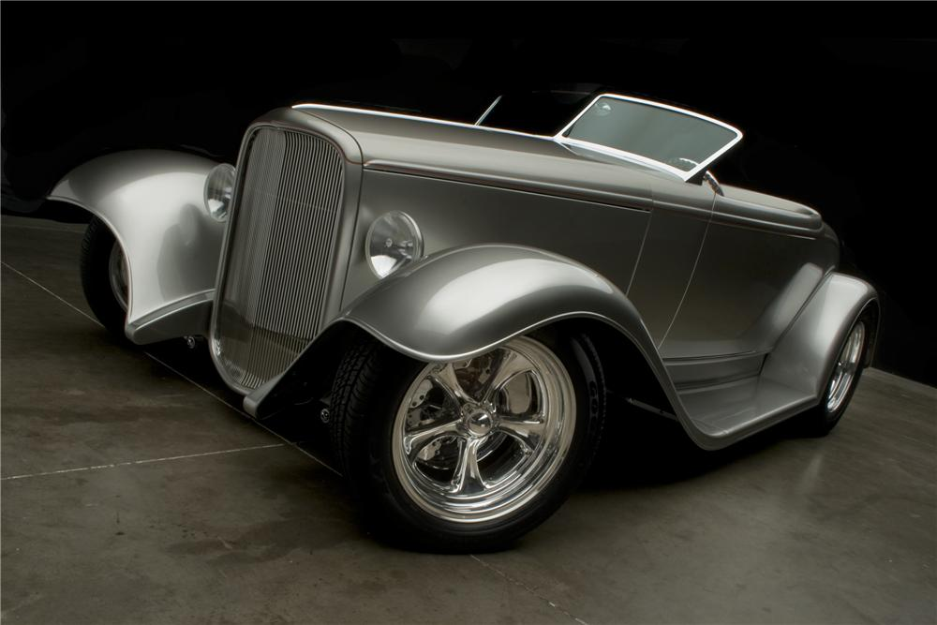
MONEY: $125000
TOKENS: 5
PRESTIGE: 275
MILE MARKERS: 4
MAKE HOME SCREEN VEHICLE
ENGINE 84%
TRANSMISSION 96%
DRIVE AXEL 87%
EXHAUST 99%
FUEL SYSTEM 74%
SELL
DRIVETRAIN
1932 FORD CUSTOM
BLACK INTERIOR
SILVER EXTERIOR
CHASIS 94%
BODY PANELS 96%
PAINT 97%
CHROME 99%
GLASS 94%
BODY
SEATS 94%
CARPET 96%
DASH 87%
DOOR PANELS 79%
HEADLINER 94%
INTERIOR
OWNERSHIP 94%
BUILD SHEET 76%
MATCHING #’S 87%
HISTORY REPORT 99%
RESTORATION 94%
DOCUMENTS
1932 FORD CUSTOM ROADSTER - Over ninety percent of the car is one-off parts. The body is all steel. Received three awards at the America's Most Beautiful Roadster Show in 2010, "Outstanding Engineering", "Achievement Award" and "Outstanding Paint."
BACK
HOME
Notes:
VEHICLE OR PROJECT PAGE – PLAYERS CAN CLICK ON WHICH AREA THEY WISH TO RESTORE. i.e. UNDER DRIVETRAIN THEY MIGHT CHOOSE ENGINE.

Slide 8
MONEY: $125000
TOKENS: 5
PRESTIGE: 275
MILE MARKERS: 4
CLASS OF CAR: RARE CAR
ENGINE 84%
TRANSMISSION 96%
DRIVE AXEL 87%
EXHAUST 99%
FUEL SYSTEM 74%
ORIGINAL CONDITION: 64%
DRIVETRAIN
CURRENT CONDITION: 91%
HIGHEST SELLING PRICE: $43,000
CHASIS 94%
BODY PANELS 96%
PAINT 97%
CHROME 99%
GLASS 94%
BODY
LOWEST SELLING PRICE: $1,500
STANDARD 24 HOUR AUCTION
SEATS 94%
CARPET 96%
DASH 87%
DOOR PANELS 79%
HEADLINER 94%
CONFIRM
INTERIOR
48 HOUR AUCTION
OWNERSHIP 94%
BUILD SHEET 76%
MATCHING #’S 87%
HISTORY REPORT 99%
RESTORATION 94%
CONFIRM (2 TOKENS)
GO BACK TO MY GARAGE
DOCUMENTS
1932 FORD CUSTOM ROADSTER - Over ninety percent of the car is one-off parts. The body is all steel. Received three awards at the America's Most Beautiful Roadster Show in 2010, "Outstanding Engineering", "Achievement Award" and "Outstanding Paint."
BACK
HOME
Notes:
VEHICLE OR PROJECT PAGE – PLAYERS CAN CLICK ON WHICH AREA THEY WISH TO RESTORE. i.e. UNDER DRIVETRAIN THEY MIGHT CHOOSE ENGINE.

Slide 9
MONEY: $125000
TOKENS: 5
PRESTIGE: 275
MILE MARKERS: 4
CLASS OF CAR: RARE CAR
ENGINE 84%
TRANSMISSION 96%
DRIVE AXEL 87%
EXHAUST 99%
FUEL SYSTEM 74%
ORIGINAL CONDITION: 64%
DRIVETRAIN
CURRENT CONDITION: 91%
HIGHEST SELLING PRICE: $43,000
CHASIS 94%
BODY PANELS 96%
PAINT 97%
CHROME 99%
GLASS 94%
BODY
LOWEST SELLING PRICE: $1,500
STANDARD 24 HOUR AUCTION
SEATS 94%
CARPET 96%
DASH 87%
DOOR PANELS 79%
HEADLINER 94%
CONFIRM
INTERIOR
48 HOUR AUCTION
OWNERSHIP 94%
BUILD SHEET 76%
MATCHING #’S 87%
HISTORY REPORT 99%
RESTORATION 94%
CONFIRM (2 TOKENS)
GO BACK TO MY GARAGE
DOCUMENTS
1932 FORD CUSTOM ROADSTER - Over ninety percent of the car is one-off parts. The body is all steel. Received three awards at the America's Most Beautiful Roadster Show in 2010, "Outstanding Engineering", "Achievement Award" and "Outstanding Paint."
BACK
HOME
Notes:
VEHICLE OR PROJECT PAGE – PLAYERS CAN CLICK ON WHICH AREA THEY WISH TO RESTORE. i.e. UNDER DRIVETRAIN THEY MIGHT CHOOSE ENGINE.

Slide 10
MONEY: $125000
TOKENS: 5
PRESTIGE: 275
MILE MARKERS: 4
1932 FORD CUSTOM ROADSTER - Over ninety percent of the car is one-off parts. The body is all steel. Received three awards at the America's Most Beautiful Roadster Show in 2010, "Outstanding Engineering", "Achievement Award" and "Outstanding Paint."
DRIVETRAIN
BODY
INTERIOR
DOCUMENTATION
28%
36%
10%
9%
SELECT
1969 FORD MUSTANG 428 CJ “R” - White with white interior, C-6 automatic, factory "R" Code with date code correct 428cid Cobra Jet, Ram Air Shaker Hood, air conditioning, sport deck rear seat, power steering and brakes, tilt-away wheel, speed control, AM radio, tinted glass and tach.
DRIVETRAIN
BODY
INTERIOR
DOCUMENTATION
28%
10%
6%
16%
SELECT
Notes:
VEHICLE PAGE – THIS IS AN OVERVIEW PAGE OF VEHICLES WITH A PERCENTAGE OF 35% AND HIGHER

Slide 11
MONEY: $125000
TOKENS: 5
PRESTIGE: 275
MILE MARKERS: 4
MAKE HOME SCREEN VEHICLE
ENGINE 14%
TRANSMISSION 26%
DRIVE AXEL 7%
EXHAUST 19%
FUEL SYSTEM 24%
SELL
DRIVETRAIN
1968 FORD MUSTANG CJ “R”
428 COBRA JET
WHITE EXTERIOR
WHITE INTERIOR
CHASIS 5%
BODY PANELS 16%
PAINT 27%
CHROME 9%
GLASS 14%
BODY
SEATS 11%
CARPET 4%
DASH 27%
DOOR PANELS 3%
HEADLINER 22%
INTERIOR
OWNERSHIP 92%
BUILD SHEET 13%
MATCHING #’S 7%
HISTORY REPORT 29%
RESTORATION 16%
DOCUMENTS
1969 FORD MUSTANG 428 CJ “R” - White with white interior, C-6 automatic, factory "R" Code with date code correct 428cid Cobra Jet, Ram Air Shaker Hood, air conditioning, sport deck rear seat, power steering and brakes, tilt-away wheel, speed control, AM radio, tinted glass and tach.
BACK
HOME
Notes:
VEHICLE OR PROJECT PAGE – PLAYERS CAN CLICK ON WHICH AREA THEY WISH TO RESTORE. i.e. UNDER DRIVETRAIN THEY MIGHT CHOOSE ENGINE.

Slide 12
MONEY: $125000
TOKENS: 5
PRESTIGE: 275
MILE MARKERS: 4
MAKE HOME SCREEN VEHICLE
ENGINE 16%
TRANSMISSION 9%
DRIVE AXEL 27%
EXHAUST 19%
FUEL SYSTEM 24%
SELL
DRIVETRAIN
1932 FORD CUSTOM
BLACK INTERIOR
SILVER EXTERIOR
CHASIS 22%
BODY PANELS 6%
PAINT 8%
CHROME 4%
GLASS 15%
BODY
SEATS 2%
CARPET 1%
DASH 21%
DOOR PANELS 11% HEADLINER / TOP 2%
INTERIOR
OWNERSHIP 23%
BUILD SHEET 0%
MATCHING #’S 0%
HISTORY REPORT 2%
RESTORATION 946
DOCUMENTS
1932 FORD CUSTOM ROADSTER - Over ninety percent of the car is one-off parts. The body is all steel. Received three awards at the America's Most Beautiful Roadster Show in 2010, "Outstanding Engineering", "Achievement Award" and "Outstanding Paint."
BACK
HOME
Notes:
VEHICLE OR PROJECT PAGE – PLAYERS CAN CLICK ON WHICH AREA THEY WISH TO RESTORE. i.e. UNDER DRIVETRAIN THEY MIGHT CHOOSE ENGINE.

Slide 13

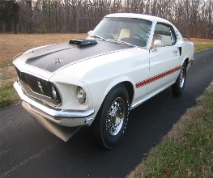
MONEY: $125000
TOKENS: 5
PRESTIGE: 275
MILE MARKERS: 4
MY GARAGE
WORK ON VEHICLES
HOME VEHICLE
OR
PIC OF BUSINESS TYPE
MY BUSINESS
WORK ON PROJECTS
UPGRADE EQUIPMENT
BAY 1
BAY 2
NEXT LEVEL
SELECT PART SUPPLIER
BAY 3
BAY 4
COMPLETE WORK
FIND BUSINESS
MY PRESIGE
VEHICLE COLLECTION
BACK
HOME
Notes:
MY GARAGE – MY BUSINESS – HOME SCREEN TO COMPLETE WORK AND UPGRADE GARAGE

Slide 14
MONEY: $125000
TOKENS: 5
PRESTIGE: 275
MILE MARKERS: 4
DRIVETRAIN
BODY
INTERIOR
DOCUMENTS
SEARCH
AAA GARAGE
BBB GARAGE
CCC GARAGE
DDD GARAGE
EEE GARAGE
FFF GARAGE
GGG GARAGE
HHH GARAGE
AAA GARAGE
BBB GARAGE
CCC GARAGE
DDD GARAGE
EEE GARAGE
FFF GARAGE
GGG GARAGE
HHH GARAGE
AAA GARAGE
BBB GARAGE
CCC GARAGE
DDD GARAGE
EEE GARAGE
FFF GARAGE
GGG GARAGE
HHH GARAGE
AAA GARAGE
BBB GARAGE
CCC GARAGE
DDD GARAGE
EEE GARAGE
FFF GARAGE
GGG GARAGE
HHH GARAGE
AAA GARAGE
BBB GARAGE
CCC GARAGE
DDD GARAGE
EEE GARAGE
FFF GARAGE
GGG GARAGE
HHH GARAGE
BACK
HOME
Notes:
SEARCH PAGE – ALLOWS A PLAYER TO SEARCH FOR A BUSINESS TO COMPLETE WORK

Slide 15


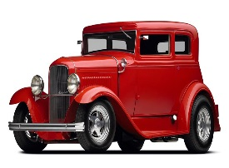


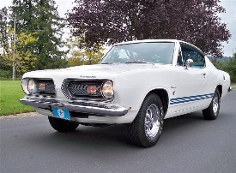
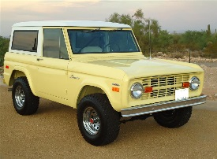




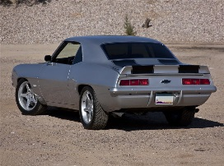
MONEY: $125000
TOKENS: 5
PRESTIGE: 275
MILE MARKERS: 4
BAY 1
BAY 2
LOYALTY
37
LOYALTY
9
LOYALTY
22
LOYALTY
10
BAY 3
BAY 4
LOYALTY
17
LOYALTY
2
LOYALTY
1
LOYALTY
0
Notes:
PARTS SUPPLY PAGE – PLAYER SELECTS WHICH VEHICLE/BAY TO WORK ON AND WHICH SUPPLER TO PURCHASE FROM.

Slide 16
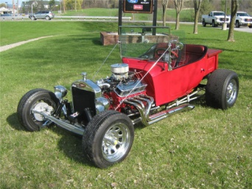
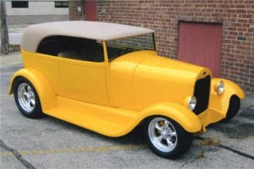
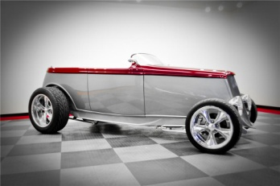
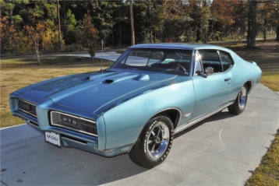
MONEY: $125000
TOKENS: 5
PRESTIGE: 275
MILE MARKERS: 4
1927 CHEVY CUSTOM T-BUCKET ROADSTER
Big block, 3-speed automatic transmission, custom interior, chrome headers and side pipes, fiberglass tub, disc brakes, chrome wheels, Mickey Thompson tires, carbon fiber dash, a real head turner.
$17,600
BID NOW
17 HOURS, 29 MINS
1929 FORD CUSTOM
All-steel Street Rod, hundreds of body mods, lift-off hardtop, 350/350hp, boxed frame, chrome dropped axle, American Racing Torq Thrust wheels and custom interior.
$50,600
BID NOW
19 HOURS, 53 MINS
1932 FORD CUSTOM 2 DOOR REMOVABLE HARDTOP
This '32 has been a combined effort over two owners and 10 years to complete with a build cost just south of $125,000. Impeccable attention to detail is shown throughout this one-off custom. Features a Chevy 502cid big block and Turbo 400 transmission.
$47,300
BID NOW
20 HOURS, 09 MINS
1968 PONTIAC GTO 2 DOOR HARDTOP
Meridian Turquoise inside and out. Original matching numbers car. 400cid, Turbo 400 transmission, power steering, power brakes, factory air conditioning, rally wheels, hood tachometer and Firestone wide ovals. Frame-off restoration.
$35,200
BID NOW
23 HOURS, 59 MINS
Notes:
BUY VEHICLE PAGE – WILL NEED SORT FUNCTION AND AFTER CLICKING ON BID NOW – POP UP WILL SHOW WITH BID AMOUNT AND CONFIRM

Slide 17
MONEY: $125000
TOKENS: 5
PRESTIGE: 275
MILE MARKERS: 4
1927 CHEVY CUSTOM T-BUCKET ROADSTER
Big block, 3-speed automatic transmission, custom interior, chrome headers and side pipes, fiberglass tub, disc brakes, chrome wheels, Mickey Thompson tires, carbon fiber dash, a real head turner.
$7,600
BID NOW
17 HOURS, 29 MINS
1929 FORD CUSTOM
All-steel Street Rod, hundreds of body mods, lift-off hardtop, 350/350hp, boxed frame, chrome dropped axle, American Racing Torq Thrust wheels and custom interior.
$5,600
BID NOW
19 HOURS, 53 MINS
1932 FORD CUSTOM 2 DOOR REMOVABLE HARDTOP
This '32 has been a combined effort over two owners and 10 years to complete with a build cost just south of $125,000. Impeccable attention to detail is shown throughout this one-off custom. Features a Chevy 502cid big block and Turbo 400 transmission.
$7,300
BID NOW
20 HOURS, 09 MINS
1968 PONTIAC GTO 2 DOOR HARDTOP
Meridian Turquoise inside and out. Original matching numbers car. 400cid, Turbo 400 transmission, power steering, power brakes, factory air conditioning, rally wheels, hood tachometer and Firestone wide ovals. Frame-off restoration.
$2,200
BID NOW
23 HOURS, 59 MINS
Notes:
BUY PROJECT PAGE – WILL NEED SORT FUNCTION AND AFTER CLICKING ON BID NOW – POP UP WILL SHOW WITH BID AMOUNT AND CONFIRM

Slide 18


MONEY: $125000
TOKENS: 5
PRESTIGE: 275
MILE MARKERS: 4
CONGRATULATIONS
YOU HAVE LISTED YOUR VEHICLE WITH
CONGRATULATIONS
YOU HAVE RECEIVED A MILE MARKER
MILE MARKER
GO TO MY PROFILE
BACK
GO TO MY GARAGE
HOME

Slide 19
MONEY: $125000
TOKENS: 5
PRESTIGE: 275
MILE MARKERS: 4
CURRENT BID
$0
24 hours, 0 mins
1932 FORD CUSTOM ROADSTER - Over ninety percent of the car is one-off parts. The body is all steel. Received three awards at the America's Most Beautiful Roadster Show in 2010, "Outstanding Engineering", "Achievement Award" and "Outstanding Paint."
CURRENT BID
$3,400
11 hours, 36 mins
1969 FORD MUSTANG 428 CJ “R” - White with white interior, C-6 automatic, factory "R" Code with date code correct 428cid Cobra Jet, Ram Air Shaker Hood, air conditioning, sport deck rear seat, power steering and brakes, tilt-away wheel, speed control, AM radio, tinted glass and tach.
BACK
HOME
Notes:
PROJECT PAGE – THIS IS AN OVERVIEW PAGE OF VEHICLES WITH A PERCENTAGE OF 34% AND LOWER

Slide 20
MONEY: $125000
TOKENS: 5
PRESTIGE: 275
MILE MARKERS: 4
LOYALTY POINTS: 37
POINTSFOR THIS PURCHASE: 37
NUMBER OF PURCHASES: 26
DISCOUNT: 2%
CURRENT
UPGRADED
DRIVETRAIN
DRIVETRAIN
TIME TO COMPLETE: 3 HOURS
ENGINE 54%
ENGINE 64%
COMPLETE NOW: 1 TOKEN
$2,400
CONFIRM
1969 FORD MUSTANG 428 CJ “R” - White with white interior, C-6 automatic, factory "R" Code with date code correct 428cid Cobra Jet, Ram Air Shaker Hood, air conditioning, sport deck rear seat, power steering and brakes, tilt-away wheel, speed control, AM radio, tinted glass and tach.
BACK
HOME
Notes:
COMPLETE WORK SCREEN

Slide 21
MONEY: $125000
TOKENS: 5
PRESTIGE: 275
MILE MARKERS: 4
LOYALTY POINTS: 37
POINTSFOR THIS PURCHASE: 37
NUMBER OF PURCHASES: 26
DISCOUNT: 2%
CURRENT
UPGRADED
BODY
BODY
TIME TO COMPLETE: 6 HOURS
PANELS 6%
PANELS 44%
COMPLETE NOW: 2 TOKENS
$21,500
CONFIRM
1932 FORD CUSTOM ROADSTER - Over ninety percent of the car is one-off parts. The body is all steel. Received three awards at the America's Most Beautiful Roadster Show in 2010, "Outstanding Engineering", "Achievement Award" and "Outstanding Paint."
BACK
HOME
Notes:
COMPLETE WORK SCREEN

Slide 22

MONEY: $125000
TOKENS: 5
PRESTIGE: 275
MILE MARKERS: 4
BACK
HOME
Notes:
COMPLETE WORK SCREEN

Slide 23
MONEY: $125000
TOKENS: 5
PRESTIGE: 275
MILE MARKERS: 4
BACK
HOME
Notes:
COMPLETE WORK SCREEN

Slide 24

MONEY: $125000
TOKENS: 5
PRESTIGE: 275
MILE MARKERS: 4
BACK
HOME
Notes:
COMPLETE WORK SCREEN

Slide 25
MONEY: $125000
TOKENS: 5
PRESTIGE: 275
MILE MARKERS: 4
CLASS OF CAR: RARE CAR
ENGINE 54%
TRANSMISSION 66%
DRIVE AXEL 87%
EXHAUST 69%
FUEL SYSTEM 14%
OWNED BY: JIM CASTLE
DRIVETRAIN
NUMBER OF TIMES SOLD: 3
HIGHEST SELLING PRICE: $43,000
CHASIS 84%
BODY PANELS 16%
PAINT 89%
CHROME 19%
GLASS 54%
LOWEST SELLING PRICE: $1,500
BODY
CURRENT BID: $22,000
SEATS 14%
CARPET 76%
DASH 87%
DOOR PANELS 19%
HEADLINER 54%
INTERIOR
BID NOW
$24,000
OWNERSHIP 14%
BUILD SHEET 96%
MATCHING #’S 17%
HISTORY REPORT 89%
RESTORATION 4%
17 HOURS, 29 MINS
GO BACK TO AUCTIONS
DOCUMENTS
1927 CHEVY CUSTOM T-BUCKET ROADSTER
Big block, 3-speed automatic transmission, custom interior, chrome headers and side pipes, fiberglass tub, disc brakes, chrome wheels, Mickey Thompson tires, carbon fiber dash, a real head turner.
BACK
HOME
Notes:
COMPLETE WORK SCREEN

Slide 26
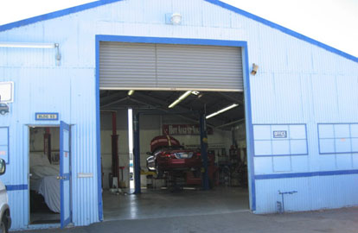
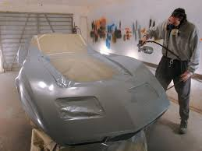
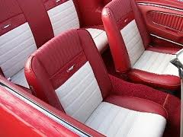

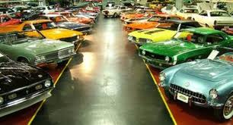
MONEY: $125000
TOKENS: 5
PRESTIGE: 275
MILE MARKERS: 4
PURCHASE AUTO GARAGE
HOME VEHICLE IF SELECTED FROM CARS OWNED
OR
EMPTY LOOKING GARAGE
IF NOT SELECTED
PURCHASE BODY SHOP
PURCHASE INTERIOR SHOP
PURCHASE DOCUMENTATION CENTER
PURCHASE MUSEUM
BACK
HOME
Notes:
BUY BUSINESS – ALL BUSINESSES START AT LEVEL 1. PLAYER CAN ONLY OWN ONE BUSINESS AT A TIME. POP UP WINDOW WILL DESCRIBE EACH BUSINESS AND HOW IT MAKES MONEY. POP UP WILL ALSO CONFIRM CHOICE

Slide 27

MONEY: $125000
TOKENS: 5
PRESTIGE: 275
MILE MARKERS: 4
EXPAND BUSINESS
UPGRADE EQUIP
SIZE OF GARAGE
CURRENT LEVEL
EXP TO NEXT LEVEL
EXP TO NEXT LEVL
NEXT LEVEL
PURCHASE TOKENS
BACK
HOME
Notes:
UPGRADE SCREEN IF NO BUSINESS IS OWNED – GARAGE SIZE DETERMINES HOW MANY VEHICLES CAN BE STORED AND TOOLS INCREASE SPEED OF WORK. GARAGE SPACE INCLUDES ROOM FOR COMPLETE VEHICELS AND PROJECT VEHICLES

Slide 28
MONEY: $125000
TOKENS: 5
PRESTIGE: 275
MILE MARKERS: 4
EXPAND BUSINESS
UPGRADE ATTRACTIONS
# OF SPACES
CURRENT LEVEL
EXP TO NEXT LEVEL
EXP TO NEXT LEVL
NEXT LEVEL
PURCHASE TOKENS
BACK
HOME
Notes:
UPGRADE SCREEN IF NO BUSINESS IS OWNED – GARAGE SIZE DETERMINES HOW MANY VEHICLES CAN BE STORED AND TOOLS INCREASE SPEED OF WORK. GARAGE SPACE INCLUDES ROOM FOR COMPLETE VEHICELS AND PROJECT VEHICLES

Slide 29
MONEY: $125000
TOKENS: 5
PRESTIGE: 275
MILE MARKERS: 4
TYPE OF BUSINESS
NUMBER OF BAYS
# OF SIMILAR BUSINESSES
NUMBER OF BAYS ALLOWED
EQUIPMENT LEVEL
NUMBER OF BAYS AT NEXT LVL
EXP TO NEXT LEVL
CONFIRM PURCHASE OF BUSINESS
BACK
HOME
Notes:
UPGRADE SCREEN IF NO BUSINESS IS OWNED – GARAGE SIZE DETERMINES HOW MANY VEHICLES CAN BE STORED AND TOOLS INCREASE SPEED OF WORK. GARAGE SPACE INCLUDES ROOM FOR COMPLETE VEHICELS AND PROJECT VEHICLES

Slide 30
MONEY: $125000
TOKENS: 5
PRESTIGE: 275
MILE MARKERS: 4
INTERIOR SHOP
NUMBER OF BAYS
# OF SIMILAR BUSINESSES
NUMBER OF BAYS ALLOWED
EQUIPMENT LEVEL
NUMBER OF BAYS AT NEXT LVL
EXP TO NEXT LEVL
CONFIRM PURCHASE OF BUSINESS
BACK
HOME
Notes:
UPGRADE SCREEN IF NO BUSINESS IS OWNED – GARAGE SIZE DETERMINES HOW MANY VEHICLES CAN BE STORED AND TOOLS INCREASE SPEED OF WORK. GARAGE SPACE INCLUDES ROOM FOR COMPLETE VEHICELS AND PROJECT VEHICLES

Slide 31
MONEY: $125000
TOKENS: 5
PRESTIGE: 275
MILE MARKERS: 4
BODY SHOP
NUMBER OF BAYS
# OF SIMILAR BUSINESSES
NUMBER OF BAYS ALLOWED
EQUIPMENT LEVEL
NUMBER OF BAYS AT NEXT LVL
EXP TO NEXT LEVL
CONFIRM PURCHASE OF BUSINESS
BACK
HOME
Notes:
UPGRADE SCREEN IF NO BUSINESS IS OWNED – GARAGE SIZE DETERMINES HOW MANY VEHICLES CAN BE STORED AND TOOLS INCREASE SPEED OF WORK. GARAGE SPACE INCLUDES ROOM FOR COMPLETE VEHICELS AND PROJECT VEHICLES

Slide 32
MONEY: $125000
TOKENS: 5
PRESTIGE: 275
MILE MARKERS: 4
DOCUMENTATION CENTER
NUMBER OF EMPLOYEES
# OF SIMILAR BUSINESSES
# OF EMPLOYEES ALLOWED
DATABASE
# OF EMPLOYEES AT NEXT LVL
EXP TO NEXT LEVL
CONFIRM PURCHASE OF BUSINESS
BACK
HOME
Notes:
UPGRADE SCREEN IF NO BUSINESS IS OWNED – GARAGE SIZE DETERMINES HOW MANY VEHICLES CAN BE STORED AND TOOLS INCREASE SPEED OF WORK. GARAGE SPACE INCLUDES ROOM FOR COMPLETE VEHICELS AND PROJECT VEHICLES

Slide 33
MONEY: $125000
TOKENS: 5
PRESTIGE: 275
MILE MARKERS: 4
MUSEUM
NUMBER OF VEHICLES
# OF SIMILAR BUSINESSES
# OF VISITORS ALLOWED
ATTRACTION LEVEL
# OF VISITORS AT NEXT LVL
EXP TO NEXT LEVL
CONFIRM PURCHASE OF BUSINESS
BACK
HOME
Notes:
UPGRADE SCREEN IF NO BUSINESS IS OWNED – GARAGE SIZE DETERMINES HOW MANY VEHICLES CAN BE STORED AND TOOLS INCREASE SPEED OF WORK. GARAGE SPACE INCLUDES ROOM FOR COMPLETE VEHICELS AND PROJECT VEHICLES

Slide 34
MONEY: $125000
TOKENS: 5
PRESTIGE: 275
MILE MARKERS: 4
CONGRATULATIONS
YOU JUST PURCHASED A
BUSINESS
GO TO MY BUSINESS
CONGRATULATIONS
YOU HAVE RECEIVED A MILE MARKER
MILE MARKER
GO TO MY PROFILE
BACK
UPGRADE NOW
HOME

Slide 35
MONEY: $125000
TOKENS: 5
PRESTIGE: 275
MILE MARKERS: 4
CONGRATULATIONS
YOU JUST PURCHASED A
BUSINESS
GO TO MY BUSINESS
CONGRATULATIONS
YOU HAVE RECEIVED A MILE MARKER
MILE MARKER
GO TO MY PROFILE
BACK
UPGRADE NOW
HOME

Slide 36
MONEY: $125000
TOKENS: 5
PRESTIGE: 275
MILE MARKERS: 4
CONGRATULATIONS
YOU JUST UPGRADED YOUR EQUIPMENT
GO TO MY BUSINESS
CONGRATULATIONS
YOU HAVE RECEIVED A MILE MARKER
MILE MARKER
GO TO MY PROFILE
BACK
UPGRADE NOW
HOME

Slide 37
MONEY: $125000
TOKENS: 5
PRESTIGE: 275
MILE MARKERS: 4
CONGRATULATIONS
YOU JUST REACHED THE NEXT LEVEL
WITH YOU BUSINESS
GO TO MY BUSINESS
CONGRATULATIONS
YOU HAVE RECEIVED A MILE MARKER
MILE MARKER
GO TO MY PROFILE
BACK
UPGRADE NOW
HOME

Slide 38
MONEY: $125000
TOKENS: 5
PRESTIGE: 275
MILE MARKERS: 4
CONGRATULATIONS
YOU JUST COLLECTED
$24,000
GO TO MY BUSINESS
CONGRATULATIONS
YOU HAVE RECEIVED A MILE MARKER
MILE MARKER
GO TO MY PROFILE
BACK
UPGRADE NOW
HOME

Slide 39
MONEY: $125000
TOKENS: 5
PRESTIGE: 275
MILE MARKERS: 4
CONGRATULATIONS
YOU JUST PLACED A BID OF
$24,000
GO TO MY GARAGE
CONGRATULATIONS
YOU HAVE RECEIVED A MILE MARKER
MILE MARKER
GO TO MY PROFILE
BACK
MY BUSINESS
HOME

Slide 40
MONEY: $125000
TOKENS: 5
PRESTIGE: 275
MILE MARKERS: 4
EXPAND BUSINESS
PICTURE WILL REPRESENT TYPE OF BUSINESS
# OF OPENINGS
BUSINESS LVL
# OF AVAIL OPENINGS
POINTS TO NEXT LVL
TOTAL PROJECT COMP
UPGRADE EQUIP
PROJECTS TO COMP
EQUIPMENT LVL
# OF W/O REQUEST
POINTS TO NEXT LVL
# OF W/O COMPLETE
NEXT LEVEL
COMPLETE W/O
TOTAL $$$ EARNED
BACK
HOME
Notes:
UPGRADE SCREEN IF BUSINESS IS OWNED – BUSINESS LEVEL DETERMINES HOW MANY VEHICLES CAN BE STORED AND EQUIPMENT LEVEL INCREASE SPEED OF WORK. BUSINESS SPACE INCLUDES ROOM FOR COMPLETE VEHICELS (CAN ALSO BE STORED IN PLAYERS PRIVATE GARAGE. NO WORK CAN BE PERFORMED FROM PRIVATE GARAGE) AND PROJECT VEHICLES. PRICE AND SPEED OF WORK INCREASE WITH EACH LEVEL. QUALITY OF WORK (AMOUNT OF IMPROVEMENT) ALSO INCREASES BASED ON LEVEL

Slide 41
MONEY: $125000
TOKENS: 5
PRESTIGE: 275
MILE MARKERS: 4
# OF AVAILABLE BAYS
PICTURE WILL REPRESENT TYPE OF BUSINESS
BAY 1
BAY 2
YOU HAVE 1 NEW WORK ORDER
PENDING WORK ORDERS
$2,300
$5,700
ACCEPT WORK ORDER
EXP POINTS
EXP POINTS
COMPLETE NOW
COMPLETE NOW
BAY 3
BAY 4
UPGRADE EQUIP
EXPAND BUSINESS
$1700
NEXT LEVEL
EXP POINTS
COMPLETE NOW
COLLECT TODAYS INCOME
NOT IN ACTUAL GAMEPLAY
CLICK TO SEE MUSEUM
BACK
HOME
Notes:
UPGRADE SCREEN IF BUSINESS IS OWNED – BUSINESS LEVEL DETERMINES HOW MANY VEHICLES CAN BE STORED AND EQUIPMENT LEVEL INCREASE SPEED OF WORK. BUSINESS SPACE INCLUDES ROOM FOR COMPLETE VEHICELS (CAN ALSO BE STORED IN PLAYERS PRIVATE GARAGE. NO WORK CAN BE PERFORMED FROM PRIVATE GARAGE) AND PROJECT VEHICLES. PRICE AND SPEED OF WORK INCREASE WITH EACH LEVEL. QUALITY OF WORK (AMOUNT OF IMPROVEMENT) ALSO INCREASES BASED ON LEVEL

Slide 42
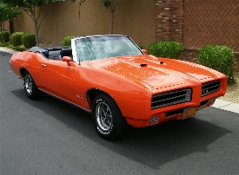
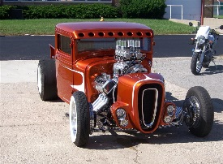
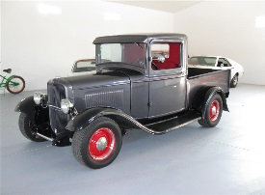
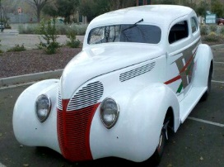
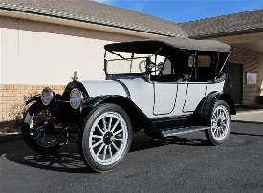
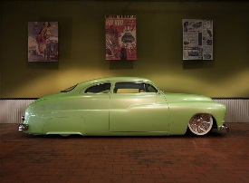
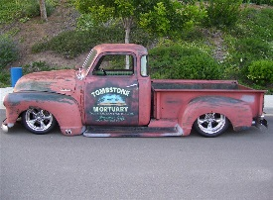
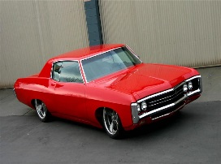
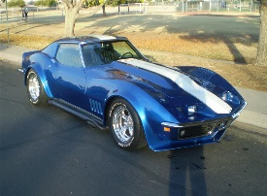
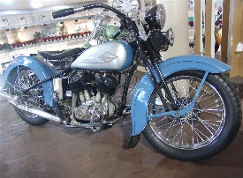
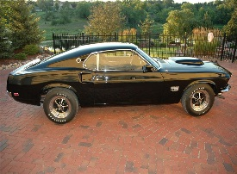
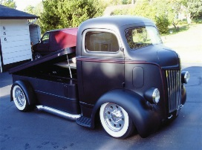
MONEY: $125000
TOKENS: 5
PRESTIGE: 275
MILE MARKERS: 4
EXPAND BUSINESS
NEXT LEVEL
BAY 1
BAY 2
BAY 3
BAY 4
BAY 5
BAY 6
BAY 7
BAY 8
BAY 9
BAY 10
BAY 11
BAY 12
BAY 13
BAY 14
COLLECT TODAYS INCOME
BAY 15
BAY 16
# OF SPACES AVAILABLE
BACK
HOME
Notes:
UPGRADE SCREEN IF BUSINESS IS OWNED – BUSINESS LEVEL DETERMINES HOW MANY VEHICLES CAN BE STORED AND EQUIPMENT LEVEL INCREASE SPEED OF WORK. BUSINESS SPACE INCLUDES ROOM FOR COMPLETE VEHICELS (CAN ALSO BE STORED IN PLAYERS PRIVATE GARAGE. NO WORK CAN BE PERFORMED FROM PRIVATE GARAGE) AND PROJECT VEHICLES. PRICE AND SPEED OF WORK INCREASE WITH EACH LEVEL. QUALITY OF WORK (AMOUNT OF IMPROVEMENT) ALSO INCREASES BASED ON LEVEL

Slide 43
MONEY: $125000
TOKENS: 5
PRESTIGE: 275
MILE MARKERS: 4
# OF VEHICLES OWNED
HOME VEHICLE IF SELECTED FROM CARS OWNED
OR
EMPTY LOOKING GARAGE
IF NOT SELECTED
TOTAL $$$ EARNED
# OF PROJECTS OWNED
TOTAL $$$ SPENT
# OF VEHICLES PURC
VALUE OF COLLECTION
# OF PROJECTS PURC
HIGHEST $$ FOR VEHIC
# OF VEHICLES RESTOR
COLLECTION POINTS
# OF VEHICLES SOLD
# OF MILE MARKERS
CHANGE HOME VEHICLE
BACK
HOME
Notes:
PROFILE PAGE – PLAYERS STATUS IN GAME – GIVES OVERVIEW OF HISTORY

Slide 44
MONEY: $125000
TOKENS: 5
PRESTIGE: 275
MILE MARKERS: 4
YOU HAVE RECEIVED A NEW WORK ORDER REQUEST. CLICK HERE TO ACCEPT
DEC. 7, 2013
DELETE
CONGRATULATIONS. YOU HAVE JUST LISTED YOUR VEHICLE WITH BARRETT-JACKSON.
DEC. 7, 2013
DELETE
CONGRATULATIONS. YOU HAVE JUST PURCHASED A 1932 FORD. CLICK HERE TO VIEW
DEC. 2, 2013
DELETE
BACK
HOME
Notes:
PLAYER MESSAGE SCREEN

Slide 45
MONEY: $125000
TOKENS: 5
PRESTIGE: 275
MILE MARKERS: 4
BUY FIRST VEHICLE
ACHIEVED WHEN PLAYER PURHASE FIRST VEHICLE.
BUY FIRST PART
ACHIEVED WHEN PLAYER PURCHASES FIRST PART FROM SUPPLIER
BUY FIRST BUSINESS
ACHIEVED WHEN PLAYER PURCHASES FIRST BUSINESS
BACK
HOME
Notes:
PLAYER MESSAGE SCREEN

Slide 46
MONEY: $125000
TOKENS: 5
PRESTIGE: 275
MILE MARKERS: 4
TOP PLAYERS OVERALL
HOME VEHICLE IF SELECTED FROM CARS OWNED
OR
EMPTY LOOKING GARAGE
IF NOT SELECTED
PRESTIGE
ADAM GLAZER
JIM CASTLE
3. SUSAN SMITH
4. TYLER DUKE
5. JOHN DOE
ADAM GLAZER
JIM CASTLE
3. SUSAN SMITH
4. TYLER DUKE
5. JOHN DOE
VEHICLE COLLECTION
TOP GAINERS
ADAM GLAZER
JIM CASTLE
3. SUSAN SMITH
4. TYLER DUKE
5. JOHN DOE
ADAM GLAZER
JIM CASTLE
3. SUSAN SMITH
4. TYLER DUKE
5. JOHN DOE
CURRENT GLOBAL RANKING
BACK
HOME
Notes:
RANKING SCREEN – PLAYER CAN SELECT TO SEE THEIR RANKING IN EACH CATEGORY

Slide 47

MONEY: $125000
TOKENS: 5
PRESTIGE: 275
MILE MARKERS: 4
HOME VEHICLE IF SELECTED FROM CARS OWNED
OR
EMPTY LOOKING GARAGE
IF NOT SELECTED
PLAYER
SEARCH
PROJECT
SEARCH
BUSINESS
SEARCH
VEHICLE
SEARCH
BACK
HOME
Notes:
SEARCH SCREEN – PLAYERS CAN SEARCH FOR SPECIFIC PLAYERS, BUSINESSES, VEHICLES OR PROJECTS

Slide 48


MONEY: $125000
TOKENS: 5
PRESTIGE: 275
MILE MARKERS: 4
FAQ
QUESTION…………..
QUESTION…………..
QUESTION…………..
QUESTION…………..
QUESTION…………..
QUESTION…………..
QUESTION…………..
QUESTION……………
QUESTION……………
QUESTION……………
QUESTION……………
QUESTION……………
QUESTION……………
QUESTION……………
HOME VEHICLE IF SELECTED FROM CARS OWNED
OR
EMPTY LOOKING GARAGE
IF NOT SELECTED
BACK
HOME
Notes:
FAQ PAGE – CLICK ON QUESTION TO GET POP UP WITH ANSWER – CREATD YOUTUBE VIDEOS ON GAME PLAY ASPECTS

Slide 49

MONEY: $125000
TOKENS: 5
PRESTIGE: 275
MILE MARKERS: 4
PURCHASE VEHICLE
SELL VEHICLE
PURCHASE PROJECT
SELL PROJECT
GO TO MY AUCTIONS
BACK
HOME

Slide 50
MONEY: $125000
TOKENS: 5
PRESTIGE: 275
MILE MARKERS: 4
HOME VEHICLE IF SELECTED FROM CARS OWNED
OR
EMPTY LOOKING GARAGE
IF NOT SELECTED
PURCHASE CASH
PURCHASE TOKENS
$50,000
$1.19
3 TOKENS
$1.19
$200,000
$1.99
5 TOKENS
$1.99
$500,000
$2.49
10 TOKENS
$2.49
$1,000,000
$3.99
10 TOKENS
$3.99
BACK
HOME
Notes:
SEARCH SCREEN – PLAYERS CAN SEARCH FOR SPECIFIC PLAYERS, BUSINESSES, VEHICLES OR PROJECTS

